Slide 1



Slide 2
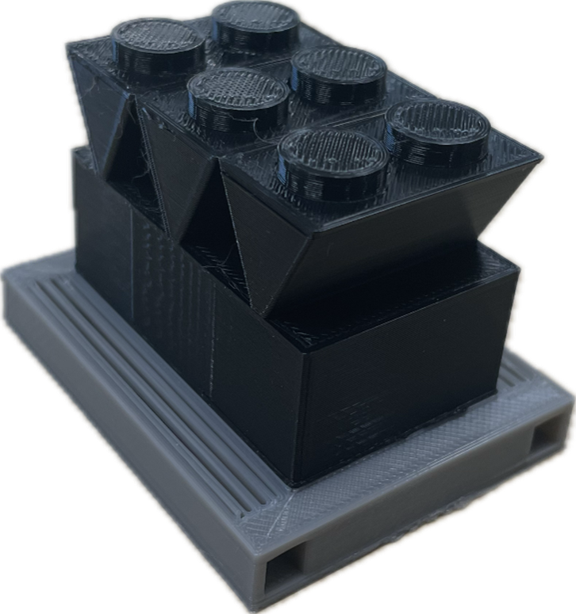
ExhaustFlow Technologies
Data Center Applications

Slide 3
Problem Overview
Data centers have always required significant cooling capacity…this is increasing exponentially with higher density data centers (liquid cooling)
Operational footprint is limited in many cases
Large Cooling Capacity + Limited Footprint = Elevated Air Temperatures (Air Recirculation)
Stability and reliability of systems are suffering due to elevated entering air temperatures
Decreased capacity of existing chillers due to elevated entering air temperatures
Increased electrical demands in order to meet power requirements for more chillers

Slide 4
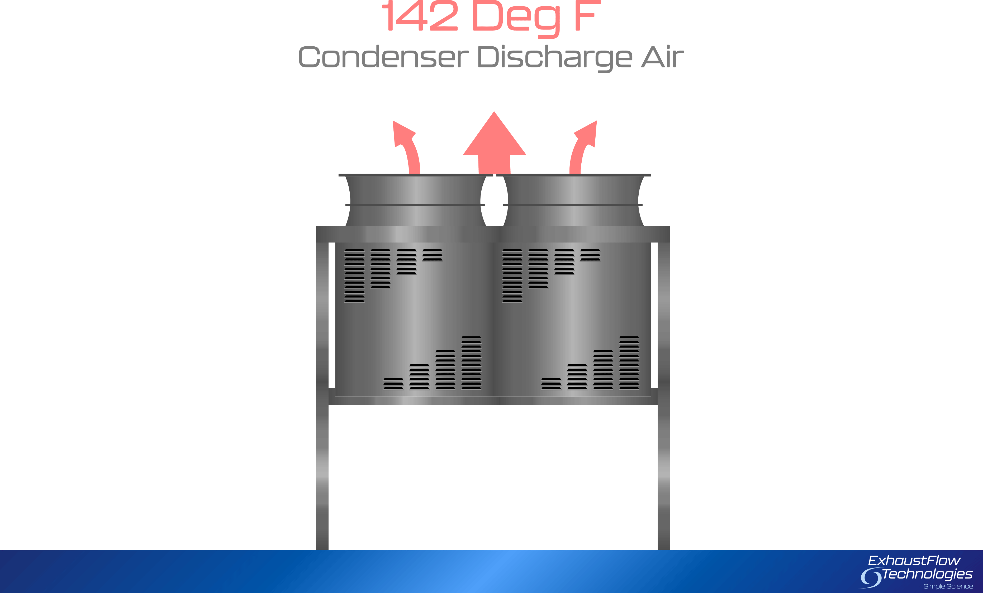
Crowded Data Centers
+
=

Slide 5
Issues Associated with Recirculated Air
Higher operating temperatures – 20° F+ higher than selected
Decreased chiller capacity – Up to 30% reduced capacity
Higher electrical consumption – Up to 20% less efficient
Larger electrical service – Bigger wire, breakers, and generators. Possibly more chillers
Unreliable, unstable chiller operation – Nuisance trips, failed components
Generator Exhaust – Poor placement will lead to higher air temperatures. (500° F+ exhaust)
Cobbled fixes applied in the field – Swapping refrigerants, using water (adiabatic), raising chillers up to the sky, etc.

Slide 6
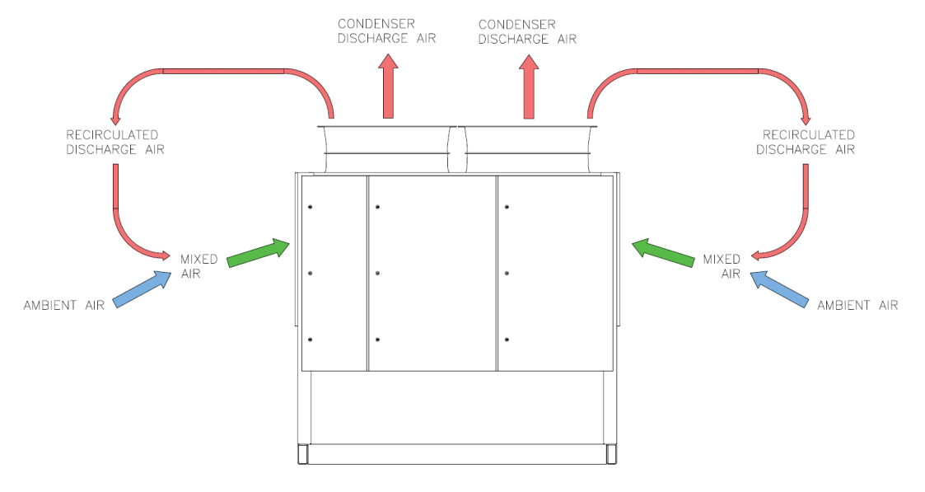
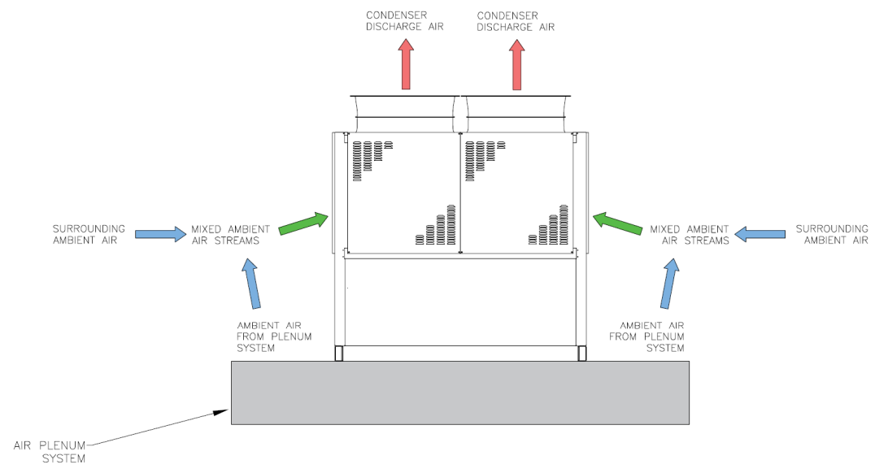
Problem Solution
Air enters air cooled chillers through the base and sides. By pressurizing the plenum base beneath the chiller, we are able to displace recirculated air and provide the chiller with raw ambient air from outside the area of operational influence

Slide 7
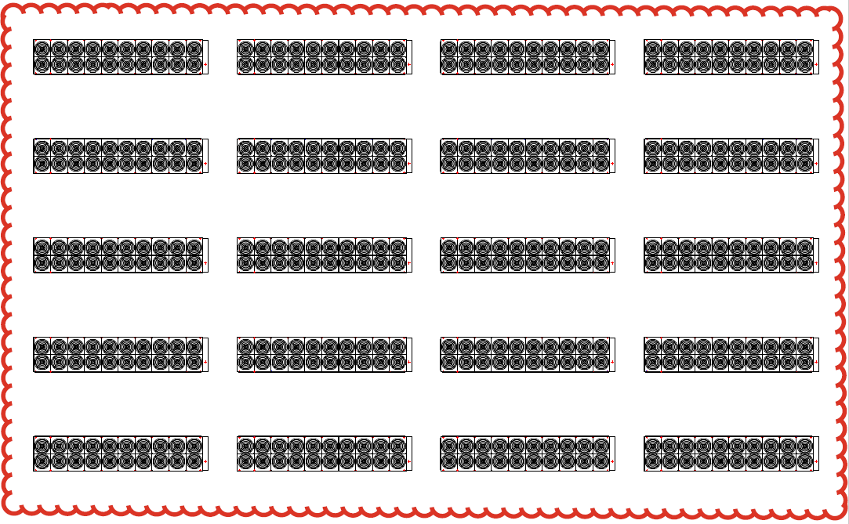
Problem Solution
Drawing ambient air from outside the data field area of influence, we can introduce raw ambient air to displace recirculated air with increased temperatures
Area of Influence

Slide 8
Problem Solution
Drawing ambient air from outside the data field area of influence, we can introduce raw ambient air to displace recirculated air with increased temperatures
Raw Ambient Air

Slide 9
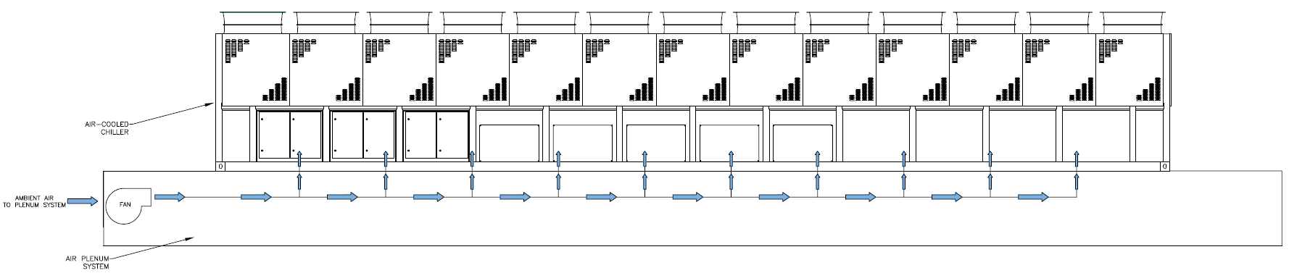

Slide 10
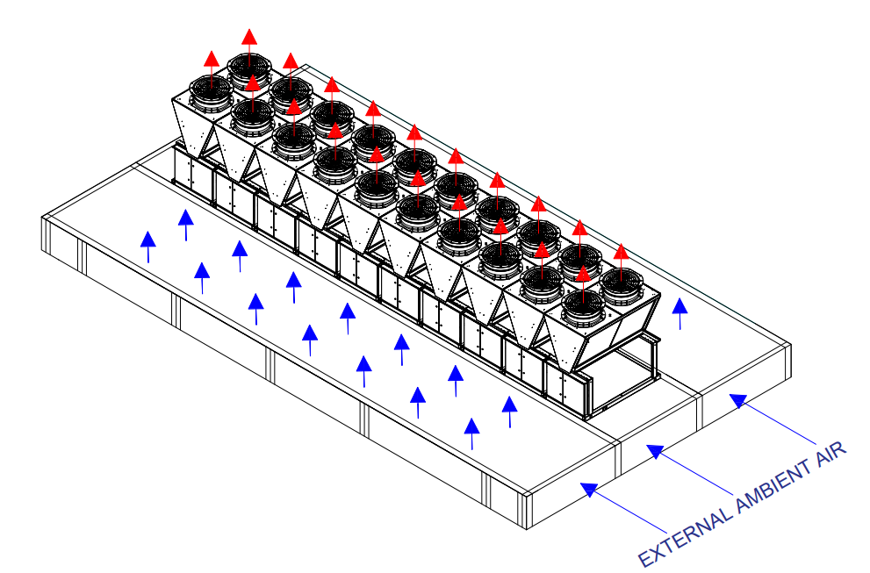
Integrated Base Solution - Concept

Slide 11
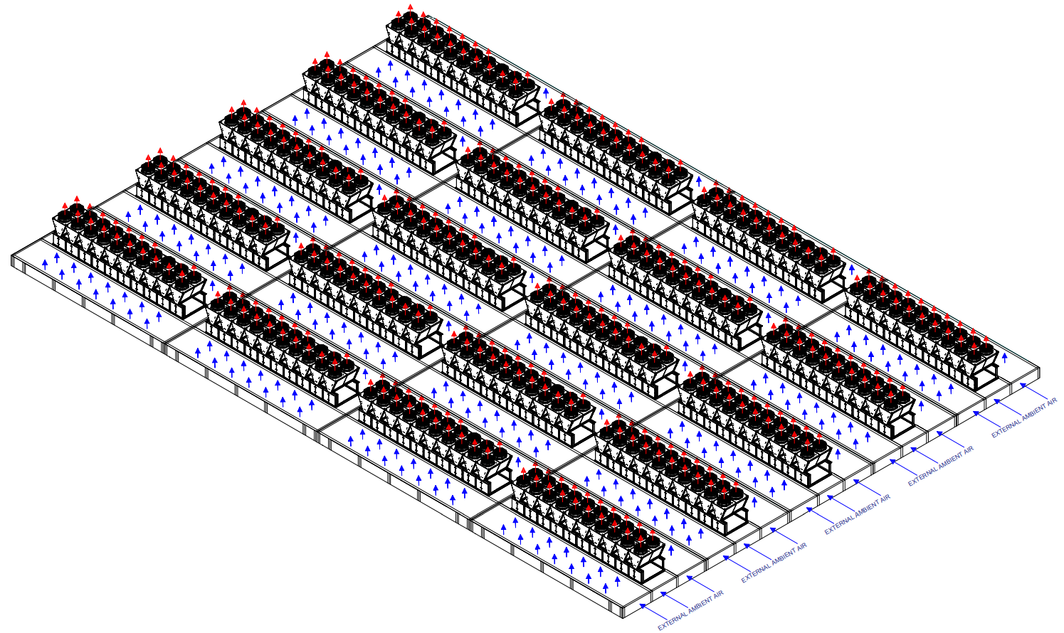
Integrated Base Solution - Concept

Slide 12
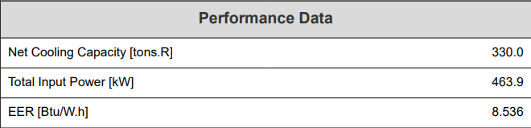
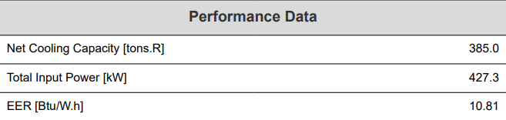
Chiller Performance Comparison
Screw Chillers - Variable Ambient Conditions
120 Degrees Ambient
Summary Table
Ambient | 120° | 105° | % Better
Cooling Tons | 330 | 385 | 17%
EER | 8.546 | 10.81 | 27%
105 Degrees Ambient

Slide 13
CFD Modeling – Air Cooled Chiller in Data Field
The intent of the CFD model was to predict the condenser airflow path for an array of chillers that would be typically applied to a data center application. The model used the assumptions below:
                20 - Total Air-Cooled Chillers
                Each Air-Cooled Chiller has 20 Condenser Fans (350 Nominal Tons)
                Each Air-Cooled Chiller was designed for 230,000 CFM of Condenser Airflow
                Open area between the chillers was 15 feet side-by-side and 8 feet end-to-end
                Each chiller thus had a domain of 7.5 feet on the sides and 4 feet on each end
                100,000 CFM of air displaced by ExhaustFlow Technologies system
The model first analyzed a single chiller to predict if this amount of spacing would cause recirculation of the condenser fans, which it did. The model then ran a simulation to displace the recirculated air by introducing fresh air through the ExhaustFlow Technologies system.

Slide 14
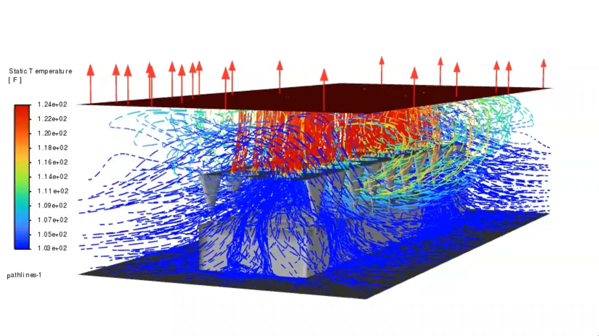
CFD Modeling – Air Cooled Chiller in Data Field

Slide 15
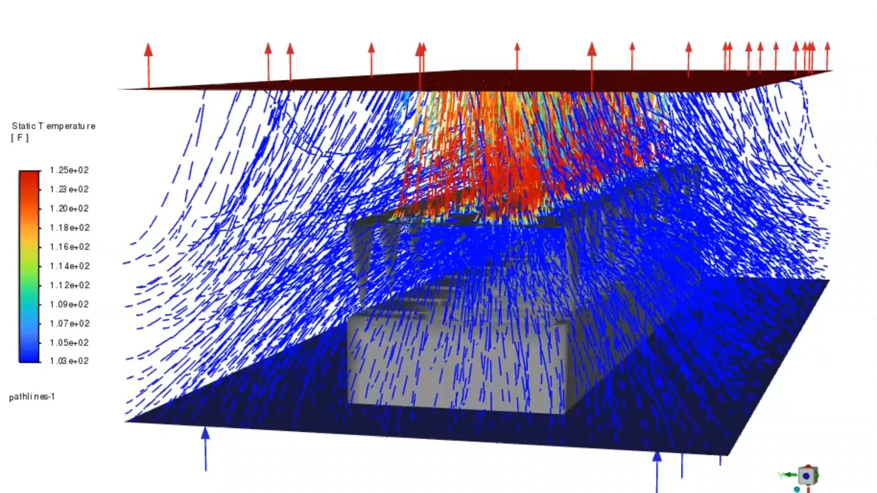
CFD Modeling – Air Cooled Chiller in Data Field with EFT Integrated Base Solution

Slide 16
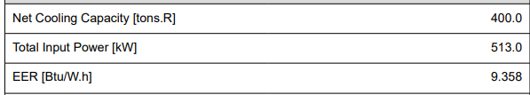
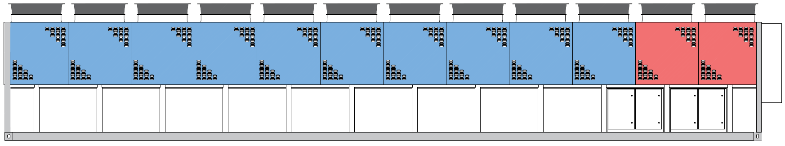
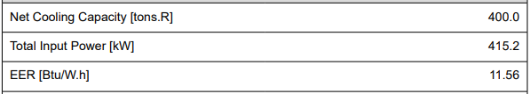
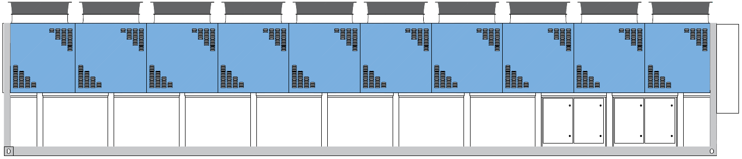
400 Ton Chiller Example
WITHOUT EFT
LENGTH - 46 FEET
98 KW DIFFERENCE
WITH EFT
LENGTH - 39 FEET
*CHILLER COST SAVINGS IS $29,000 PER CHILLER*

Slide 17
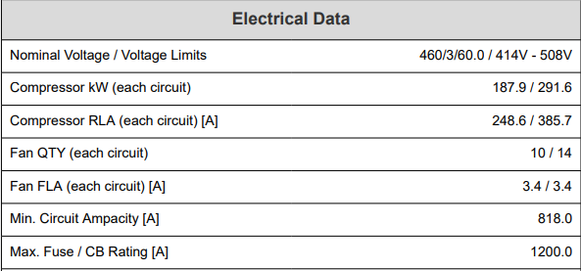
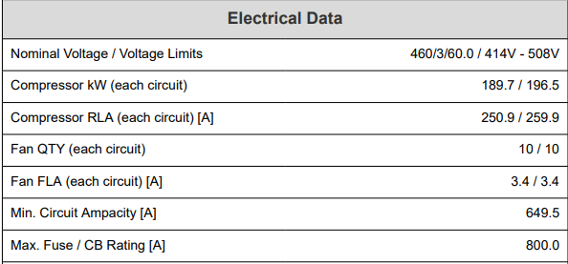
400 Ton Chiller Example - Electrical
WITHOUT EFT
Metric ⚡ | W/O EFT | W/ EFT ↓ | % Reduction ↓ | Benefits
FL kW/ton | 1.28 | 1.04 | 18.8% | Lower energy costs
Input KW | 513 | 415 | 19.1% | Smaller Generators
MCA | 818 | 650 | 20.5% | Smaller Wire Size
MOP | 1200 | 800 | 33.3% | Smaller Breakers
WITH EFT

Slide 18
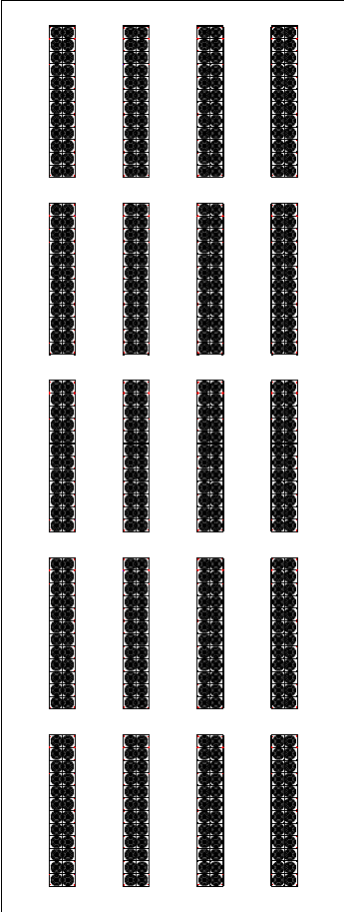
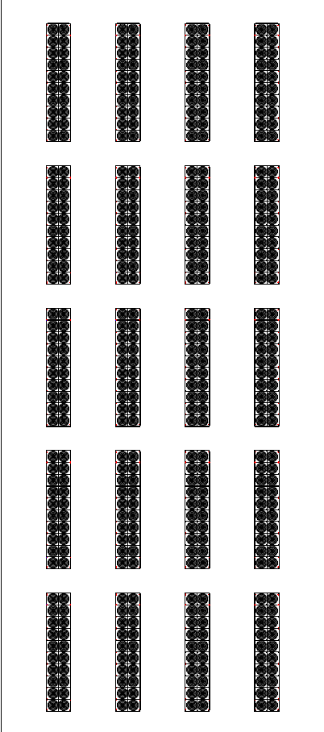
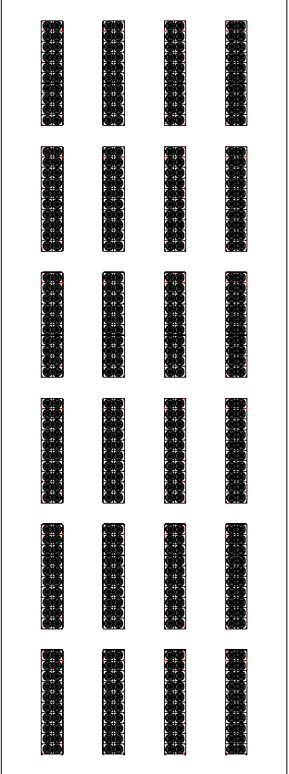
400 Ton Chiller Example - Footprint
WITHOUT EFT – (20) 400 Ton Chillers – 8,000 Total Tons
WITH EFT – (20) 400 Ton Chillers – 8,000 Total Tons
WITH EFT – (24) 400 Ton Chillers – 9,600 Total Tons
*PROVIDE SAME TONNAGE FOR 20% LESS FOOTPRINT OR 20% MORE CAPACITY FOR SAME FOOTPRINT.*

Slide 19
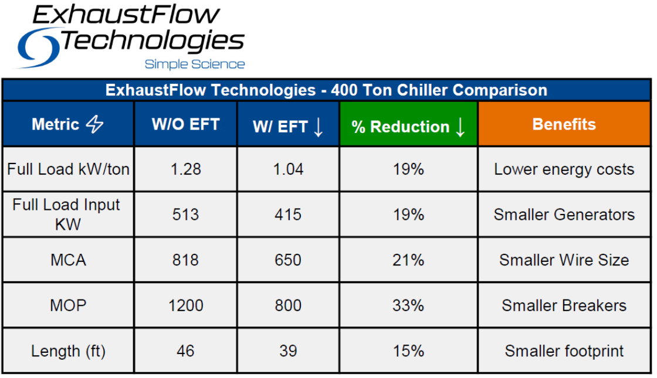
200MW Project

