Slide 1
Mitel and Microsoft Teams

Slide 2
How to Use This Deck
Mitel + Microsoft Teams Deck
Customer-facing slides to help you tell the Mitel and Microsoft Teams story
Pick and choose
Pick and choose the slides relevant to your presentation or use the deck as-is
Already know your prospect’s Mitel product?
Product-specific slides are provided in the Backup Slides sections.
Jump to MiCloud Connect Backup
Jump to General Mitel Backup

Slide 3












The Future of Work is Now
Traditional Employee
Your New Workforce
Works 9-5
Works anytime
Works in a cubicle
Works anywhere
Uses company equipment
Works on any device
Task-oriented
Results-oriented
Keeps information
Shares information
Cares more about money
Work-life balance
Notes:
Times have been changing – this crisis has accelerated that. Gone are the days where employees work 9-5 in a cubicle on company equipment. They are results oriented, freely sharing information and seeking a work-life balance that allows them to work anywhere, any time and on any device.
And now, given the epidemic plaguing our world, we have to find ways to facilitate remote working and foster communication between employees who used to be able to holler over a cube wall, who are now limited to the communication tools you currently have available.
The virus that causes COVID-19 has exposed holes in IT communications strategy and productivity is suffering as employees try to figure out how to communicate in this new world.

Slide 4

The New Way of Working: Key Learnings & Action Steps
Key Learnings
Action steps
Remote working will persist
Treat this as the new order of business
Begin to reevaluate your business policies to facilitate expanded remote working workforce
We’re all at different points
in this journey
Let people, processes, and technology guide your strategy
Analyze short-term fixes that could become long-term strategies
Don’t create application overload for your users
Reduce disjointed technologies in favor of seamless communications
Notes:
This period of prolonged isolation has proven that we can survive and be productive in a remote working environment. So embrace it. Make the adjustments to your operating policies communications strategy to account for and leverage this new flexibility of your workforce.
It’s important to realize that we are all at different points in this journey to recovery, and we will progress at different paces. Let people, process and technology guide your decision making.
Even if the impact of coronavirus is not as significant for you as it has been for others, we’ve learned that no one is fully optimized. Review the short term fixes and determine which can become long-term strategies and document your learnings to develop a crisis playbook you can use in the future.
As we talked about a moment ago, the power of technology facilitates the elasticity of your workforce and your customer base. Elasticity removes location away from the continuity of your business, where your people are has nothing to do with the productivity of your business anymore. Technology gives you the anytime/anyplace on any device type of work. Work to achieve seamless communications and collaboration across your systems and invest in improving your capacity to provide an exceptional customer experience.

Slide 5

Mitel and Microsoft Teams
Enhance your Microsoft Teams solution with Mitel enterprise-grade voice
Save
Time
Reduce Costs
Total
Solution
Direct routing and
easy dialers
No additional
expensive licensing
Enterprise-grade
telephony features, including contact center and CRM integrations
Notes:
Mitel provides enterprise-grade telephony that complements Microsoft Teams’ collaboration capabilities. Pairing Mitel with Microsoft Teams will help customers save time with easy-to-use direct routing and dialers, reduce costs by avoiding expensive Microsoft licenses and will provide a total solution with features such as contact center and CRM integrations.

Slide 6


Consolidate on a Set of Key Tools
Too many tools means headaches for management. Consolidate by combining Microsoft and Mitel.
Mitel:
  Mission-critical communications
  Flexible phones: desk, softphone, mobile options for the same number
  Advanced voicemail - move voicemail away from email and into visual voicemail
  Real-time, rich presence and availability
  Ring Group control
  Active Directory sync / SSO
  Calendar sync
  Contact center
  Integrations
Microsoft Teams:
  Video (Personal, Room, Internal / External)
  Document Sharing and Collaboration (particularly if they are Office365)
  Non Real Time Chat (1:1 or 1:Many Chats and Internal Forum / Posting type messaging)
Microsoft Outlook:
  Email
  Calendar
  Directory (Personal, Corporate)
  Calendar Sync
Notes:
Having too many tools creates complexity that companies don’t need. By combining Mitel and Microsoft you’ll get the benefits of a true communications solution, plus the productivity tools that come with Microsoft Teams and Outlook.

Slide 7
Integration Options
DIRECT ROUTING
Using a Mitel Certified SBC to SBC, organizations can connect their Mitel telephony infrastructure to make calls from within the Microsoft Teams environment.
CLICK-TO-DIAL & HOTKEYS
Create hotkeys for dialing direct from the Microsoft Teams application.
With web dialers, get click-to-dial functionality when using the web-based Microsoft Teams application.
THIRD-PARTY
INTEGRATION
With Call2Teams, integrate your Mitel phone system with Office 365, enabling softphone functionality within the Microsoft Teams environment.
MITEAM MEETINGS BOT
The Mitel Assistant is a bot that allows users to launch a MiTeam Meeting directly in the Microsoft Teams app through 1:1 or group chats. Users can easily escalate from chat to video.
Notes:
There are three ways Mitel works with Microsoft Teams: direct routing, click-to-dial/hotkeys and third-party integration. See slide 9 for a full list of which methods are available on which Mitel products.

Slide 8


Demo: How Mitel and Microsoft Teams Work Together
Notes:
This is a demo video of the ways Mitel and Microsoft Teams works together.

Slide 9
Mitel with Microsoft Teams Integrations
Integrations | MiVoice Business | MiVoice Connect | MiCloud Connect | MiVoice MX-ONE | MiVoice 5000 | MiVoice Office 400
Direct Routing (SBC-SBC) MSA Certified Session Border Controller | ü | ü |  | ü | ü | ü
Hotkey Dialing Select a phone number in MS Teams and use the hotkey combination to initiate a call | ü | ü | ü | ü | ü | ü
Call2Teams (3rd Party) Integrates any Mitel phone system with Office 365 enabling the Calls feature within Microsoft Teams. | ü |  |  | ü |  | ü
Web Dialer / Extension Within the MS Teams web user interface, you can click to dial a number. | ü | ü | ü | ü | ü | ü
Mitel Assistant Download the Mitel Assistant in the MS Teams store to launch MiTeam Meetings | ü | ü | ü | ü | ü | ü
MiCloud Connect for Teams The client will be registered as a SIP phone within your MiCloud Connect instance. |  |  | ü
Notes:
For organizations that are committed to Microsoft Teams, Mitel offers several integration options to enhance Teams with enterprise-class voice capabilities. The table above illustrates the various integrations available and the corresponding Mitel platforms that are supported.

Slide 10



Mitel + Microsoft Summary
Reevaluate communications workflows to ensure you have the tools you need for long-term success
Consolidate tools to reduce application overload, lower total cost of ownership and increase productivity
Enhance Teams experience with advanced telephony, call routing and contact center solutions

Slide 12






MiCloud Connect + Microsoft Teams
Click-to-Call
Save time and reduce entry errors by simply clicking on any phone number to place a call.
Advanced Telephony
Enhance your collaboration experience with call routing, hunt groups, presence, call history, call merging and more.
Single Sign-On
Eliminate multiple logins with our Active Directory integration for a single password across systems.
Outlook Integration
Easily schedule meetings and automate your presence and call routing as your schedule changes.
Contact Center
Improve your customer experience with our integrated or over-the-top options for simple or robust contact center capabilities.
CRM Integration
Increase agent efficiency with our native CRM integrations including Microsoft Dynamics and Salesforce.
Notes:
MiCloud Connect has some unique ways to work with Microsoft Teams. The benefits of MiCloud Connect and Microsoft Teams include clik-to-call, advanced telephony, single sign-on, Outlook integration, contact center and CRM integrations.

Slide 13
Demo: How MiCloud Connect and Microsoft Teams Work Together

Slide 14
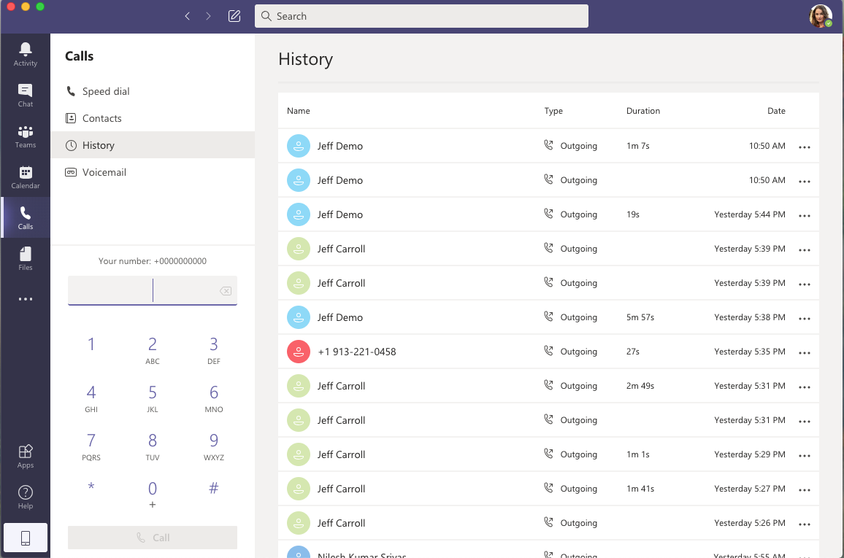
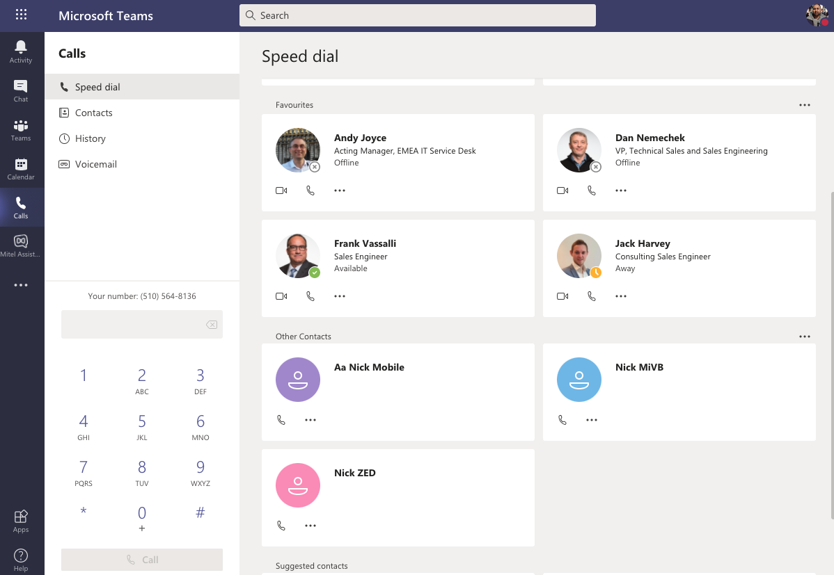
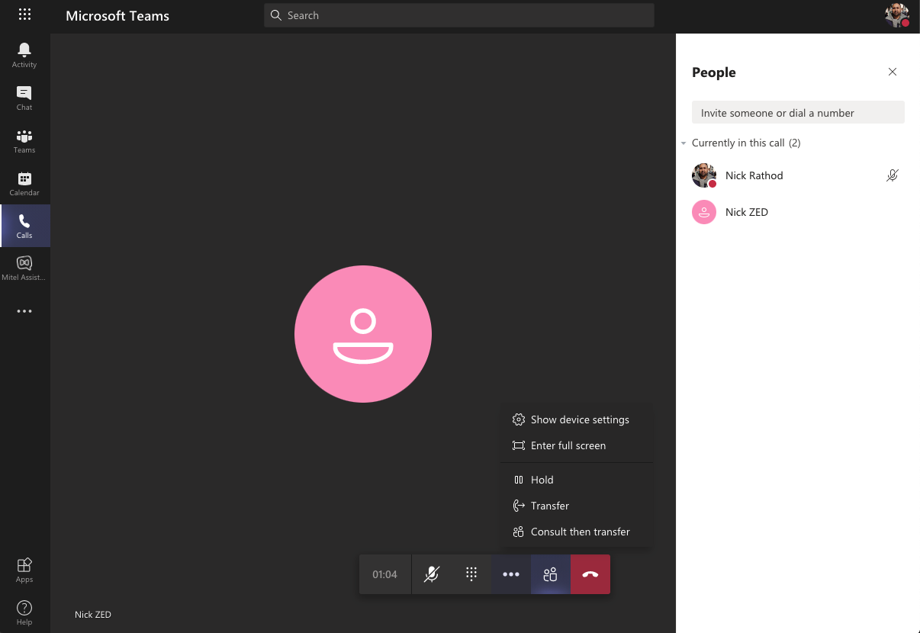
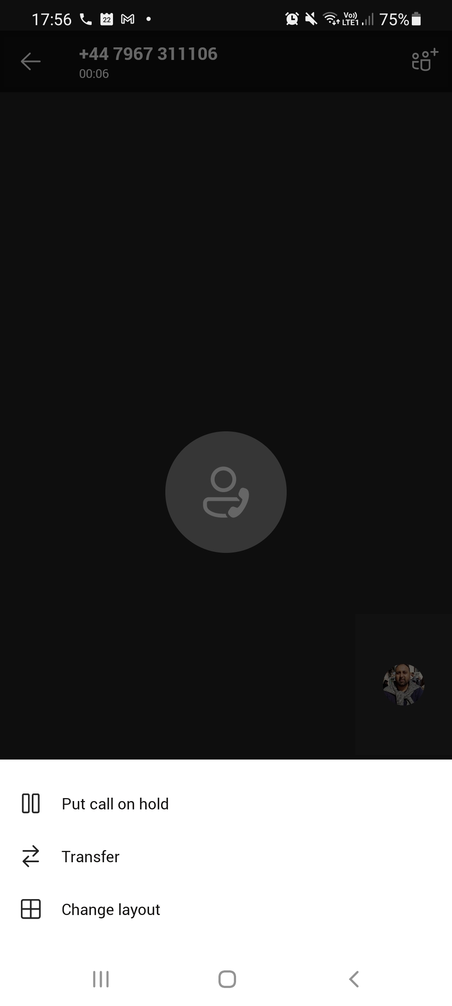
MiCloud Connect for Microsoft Teams
Integrated Mitel telephony
Click-to-dial
Seamless experience with Mitel’s enterprise telephony features
Notes:
MiCloud Connect is a direct routing option for MiCloud Connect, enabling users to stay in the Microsoft Teams UI.

Slide 15
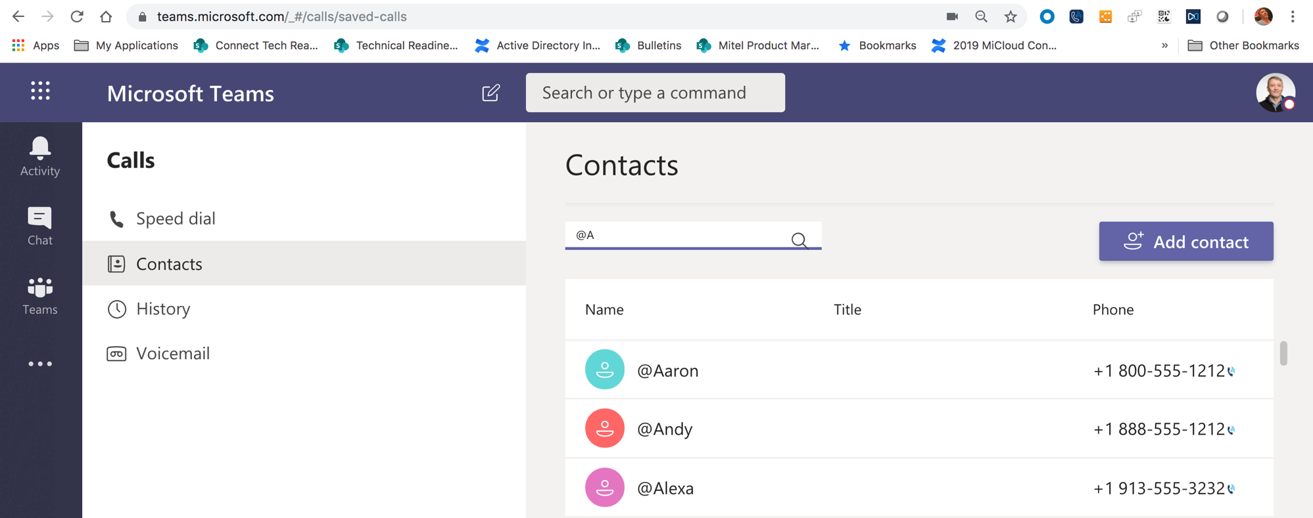
Connect Browser Click to Dial
MS Teams Browser + Connect Chrome Extension
Chrome browser extension
Click-to-dial
Softphone
Call history
Voicemail
Call merging / hold
Click to call via Mitel
Notes:
The MiCloud Connect Chrome extension enables a click-to-dial button on phone numbers within the web version of Microsoft Teams.

Slide 16
MiCloud Connect Desktop Click to Dial
MS Teams Desktop + Connect App Dialer for Hotkeys
Highlight and enter keystrokes for easy dialing
Notes:
The MiCloud Connect app dialer enables hotkeys to dials numbers from within the Microsoft Teams desktop application.

Slide 17
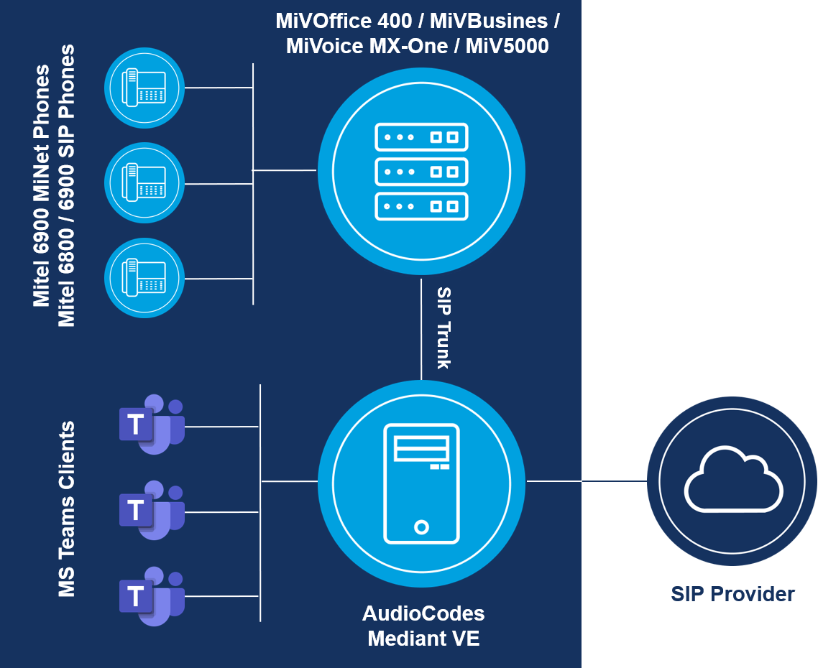

Direct Routing - Mitel, MS Teams and AudioCodes
  Connect complete Mitel telephony infrastructure to
  Microsoft Teams with a certified Session Border Controller.
  With Session Border Controller (SBC)
  AudioCodes Mediant
  Virtual Edition (VE) 7.20A.252.011
Option:
SIP-trunk connection between MiVoice PBX via
SBC* to MS Teams
Routing plan configured in PBX
Full telephony integration in MS Teams including
dialing from contact cards, escalate from chat etc.
No Mitel software or apps involved; keep full control of PTSN and billing
*Direct Routing certifications have been performed using the AudioCodes Mediant SBC (common firmware/support for Mediant 500L/500/800/1000/ CloudBond 365)
Notes:
Direct Routing is a complete Mitel telephony infrastructure to Microsoft Teams integration with a certified Mitel Solutions Alliance (MSA) certified Session Border Controller. Using direct routing, organizations can connect their Mitel telephony infrastructure to make calls directly from within the Microsoft Teams environment.

Slide 18
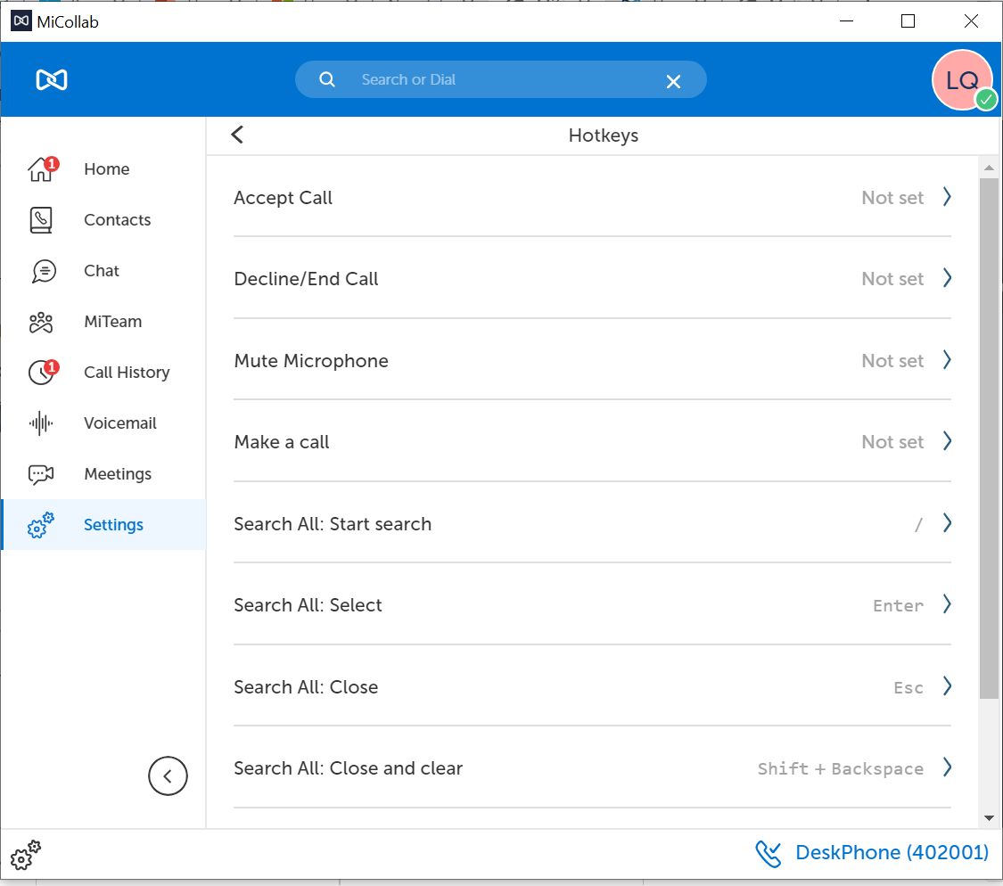
MiCollab Hotkey Dialing
Included with MiCollab
Dial phone numbers from other applications
Simply go to Settings and manage your hotkeys, then highlight the number you wish to dial and use the key strokes to dial
Notes:
Hotkey Dialing is included with MiCollab. You can easily set up hotkeys to dial. Then just select a phone number in Microsoft Teams and click the MiCollab hotkey combination to initiate a MiCollab call to the phone number.

Slide 19
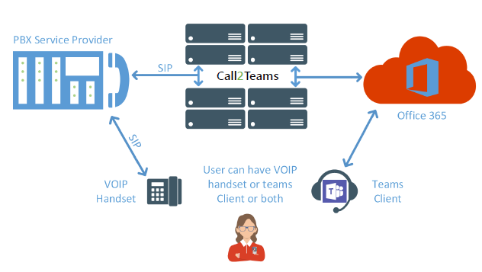
Call2Teams (Qunifi)
Make and receive business calls in Teams from Android and iOS, and easily add video and sharing
PSTN calling through your existing phone system ensures every user can make and receive calls
Collaboration and voice together: Call2Teams enables the ability to call when and where users need to
Call2Teams registers a Teams client as a SIP device on the existing PBX
Notes:
Call2Teams is a third-party solution that integrates a Mitel phone system with Office 365, enabling softphone functionality within the Microsoft Teams environment.
You can easily make and receive calls within Teams from Android and iOS, and easily add video and sharing as well.

Slide 20
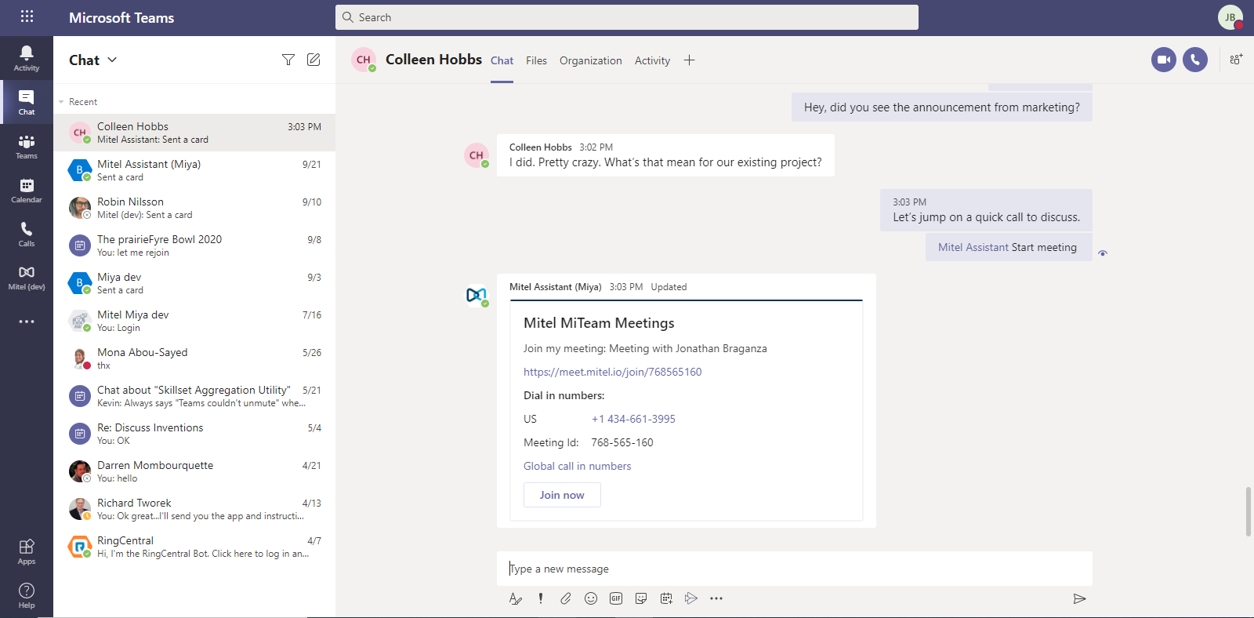
Mitel Assistant
MS Teams + MiTeam Meetings Bot
With the Mitel Assistant you can:
Initiate a MiTeam Meeting
Escalate a chat to a meeting
Download from the MS Teams Store
Coming soon:
  Integrated Mitel telephony​
  Click-to-dial​
  Seamless experience with Mitel’s enterprise telephony features

